Slide 1
Security
Munish Arora
Security
Securing Power BI Report

Slide 2
Security
Security Overview in Power BI
Implementing Row Level Security
Static Method
Dynamic Method

Slide 3

Lesson 1: Overview

Slide 4
Security overview in Power BI
The Power BI service is built on Azure
The Power BI service architecture is based on two clusters –
Web Front End (WFE) cluster and
Back-End cluster.
The WFE cluster manages the initial connection and authentication to the Power BI service, and once authenticated, the Back-End handles all subsequent user interactions.

Slide 5
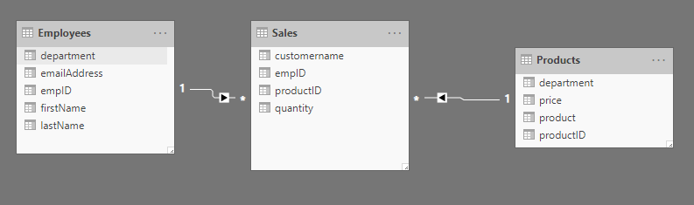
Security overview in Power BI
In Power BI, you can secure reports and workspaces by sharing them to active directory users and groups.
It is also possible to share a single report, but have users see different data, according to their job role.

Slide 6
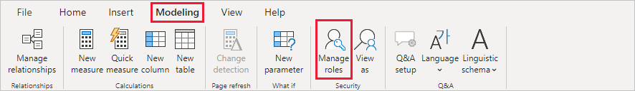
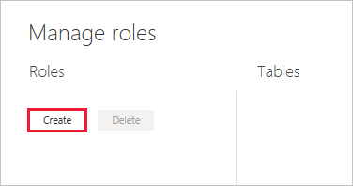
Row Level Security in Power BI
There are two ways to implement row-level security in Power BI:
Static method and
Dynamic method.

Slide 7
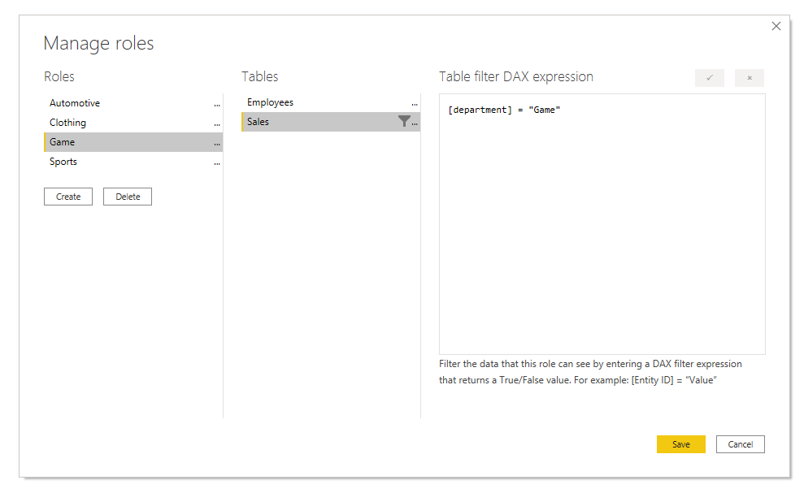
Static Method
Uses a fixed value in the DAX filter.

Slide 8
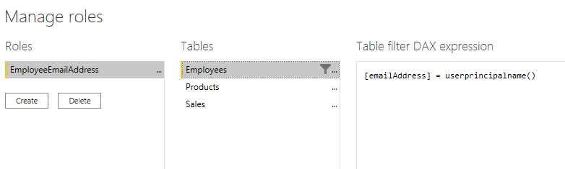
Dynamic Method
Uses a dynamic value in the DAX filter.

Slide 9
Knowledge Check
Q01 – Which function will tell you the logged on username in the Power BI Service?
USERPRINCIPALNAME()
USERNAME()
PRINCIPALNAME()
A01 - A
Q01 – Where can you test RLS by using different security roles?
Power BI Desktop
Power BI Service
Both Power BI Desktop and Power BI Service
A01 - A

Slide 10
Lab 09: Enforce Row-Level Security
In this lab you will create a many-to-many relationship between the Salesperson table and Sales table. You will also enforce row-level security to ensure that a salesperson can only analyze sales data for their assigned region(s).
In this lab you learn how to:
Configure many-to-many relationships
Enforce row-level security

